Slide 1
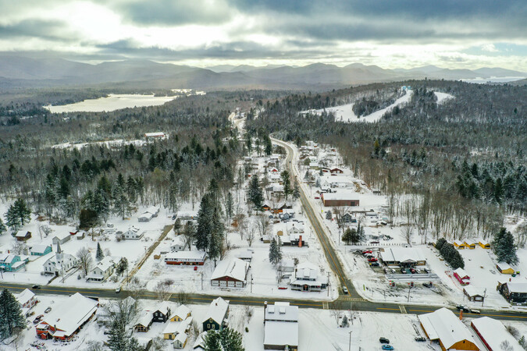
Next Steps Main Street America Project
Presented by:
Indian lake Community Development Corp. & Town of Indian lake

Slide 2
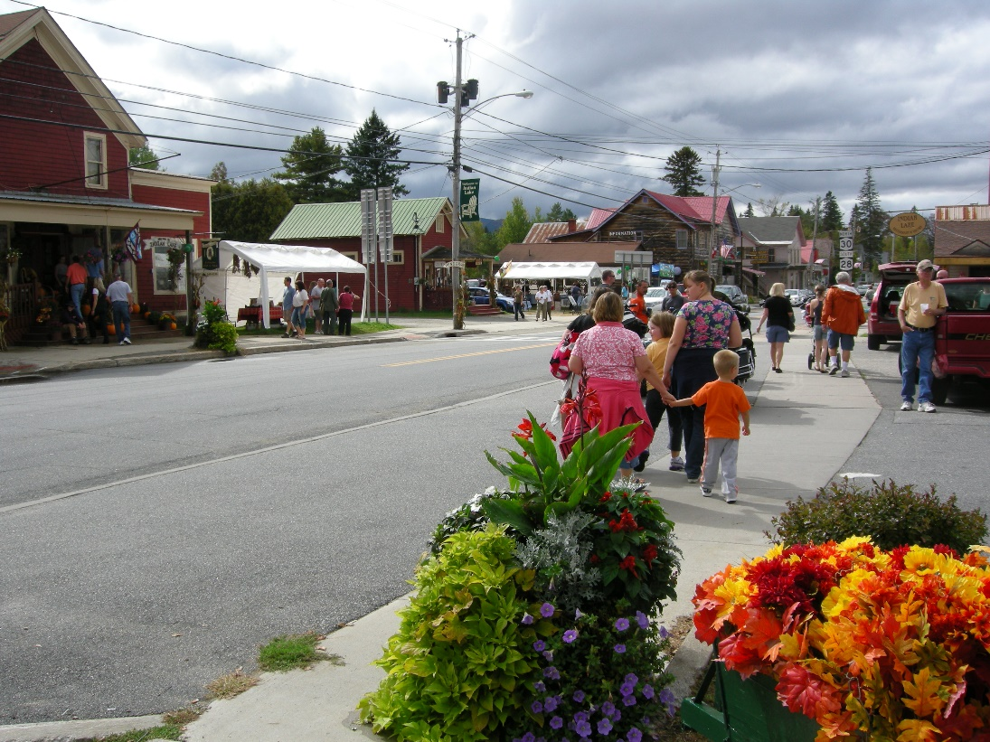
Tonight’s Agenda
Committee Oversight & Structure
Four Working Groups
Name our Project
Timeline & Next Steps

Slide 3
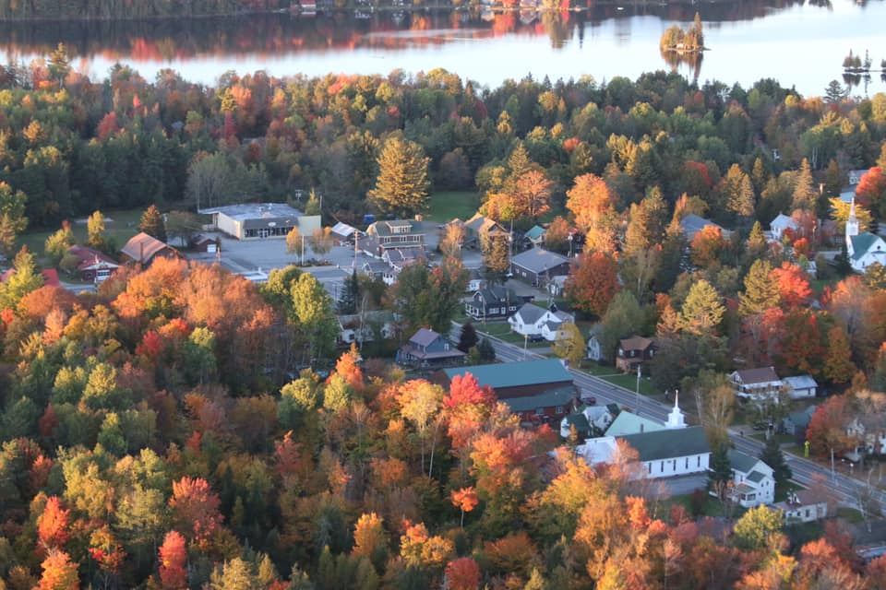
Background
Main Street America Consultant visited in August 2022, sharing community survey results
Focus group meetings, public meetings, and Zoom sessions followed
Core Steering Committee established: Brenda Valentine, Connie Sahler, Sarah Lewin, Sally Stanton, Allen Van Hoff, Kim Ameden and Christine Pouch
Now seeking volunteers to serve on four working groups

Slide 4
Organizational Structure Community Transformation via MSA
Indian Lake Community Development Corporation – 501c3 – ilcdc.org
Main Street America (MSA) Project
Core Steering Committee
Main Street America Four-Point Approach/ The Pillars of Transformation
Economic Vitality
Design
Promotion
Organization

Slide 5
Economic Vitality
Definition:
Strengthen & diversifies the local economy supporting existing base, entrepreneurism and appropriate development.
Examples:
Supporting the needs of existing & new businesses; trainings; loan & grant funds; inventory vacant buildings; survey business owners to discover needs.
How to Accomplish:
Information + Grants + Fundraisers
Volunteers to Date:
Sarah Lewin, Helen Glass

Slide 6
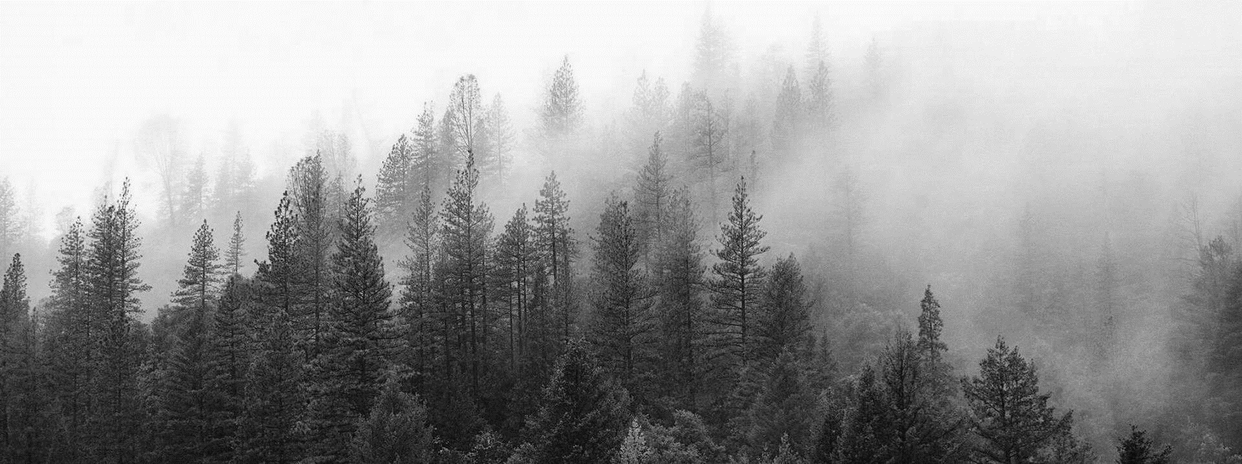
Economic Vitality: Sample Projects
Use/create an online business directory to highlight a business of the week/month.
Start a “Love your Local” business program.
Develop a packet to attract new businesses/developers to support additional recreational offerings (outfitters, equipment rentals, brew pubs, bakery, etc.)
Work with businesses to provide a range of “open hours” opportunities/stager holiday/vacation closings.
Use data collection from community survey to influence change.
Establish loan/grant programs just for “main street businesses” for upgrades/improvements.
Create various fundraisers/write grants to support all working group projects

Slide 7
Design
Definition:
Improves physical elements while preserving the community's authentic fabric, character & identity.
Examples:
Beautification; wayfinding; accessibility and safety; minor/easy maintenance; and façade improvements.
How to Accomplish:
Positive Image / Wow Factor
Volunteers to Date:
Marti Evanoff, Al Pouch, Mary Prusko, Connie Sahler

Slide 8
Design: Sample Projects
Develop wayfinding signage to identify businesses and amenities.
Conduct sidewalk safety/walkability inventory list.
Add bike lanes.
Community gardens/flowers galore.
Dog park and sanitation stations.
Downtown lighting review.
Residents ONLY parking.
Benches, bike racks and trash cans
Bike rentals
Fitness stations on trails.
Water refill stations.

Slide 9
Promotion
Definition:
Positions district as the center of activity, culture, commerce, and community life, markets its assets and positive image.
Examples:
Overall branding; unify/link hamlets; identify historic landmarks; and market our assets. Elder & family friendly activities.
How to Accomplish:
Marketing & Events
Volunteers to Date:
Barbara Smorgans Marshall

Slide 10
Promotion: Specific Projects
Welcome Packet (we have this now!)
Community calendar inclusive of ALL events.
Infor for LOCALS ONLY on website.
Print & digital newsletter
Host events that serve residents only – Trick or Treat, Easter egg hunt, Locals shopping night.
News releases and social media videos to promote our efforts.
Downtown Dollars program.
Promote hashtag #indianlakeadk

Slide 11
Definition:
Brings the community together to build consensus & common vision, assemble resources, and lead revitalization.
Examples:
Engaging all parties to get involved; establish common vision; lead the revitalization; and keep things on track.
How to Accomplish:
Structure/Work Plan/Volunteer Engagement/Advocacy
Volunteers to Date:
Marti Evanoff
Organization

Slide 12
Organization: Specific Projects
Create volunteer database for events and activities.
Promote historic walking tours.
Partner with other communities to promote regional amenities.
Develop bike tours.
Shuttle service.
Support funding efforts.

Slide 13
Work Group Recruitment
Work Group Structure
Each Work Group needs a chair/co-chair
Each Work Group conducts their own meetings and report back to Core Committee
Each Work Group can make recommendations for priority project(s) & determine needs (materials, money, people) to be added to Master Plan
MSA training tools & modules are available for guidance
So, which Work Group(s) are you interested in joining?

Slide 14
We Need Our Own Identity!
What Do We Call This Group/Project?
Main Street America prefers communities to focus on a core downtown area. Well, we are not like most communities. (The Crossroads of Rtes 28 & 30?)
Our focus is on all three hamlets which make up the Town of Indian Lake. We will work together to benefit all.
Each Working Group should suggest a “Name” and we’ll collectively chose one.

Slide 15
Timeline: Subject to Change
April
Chair(s) from Work Groups meet w. Core Committee
Today
1/25/23
June – December
Project Implementation; Fundraising; PR
February – March
Work Groups commence; volunteers recruited
May
“Name” Chosen; priority projects defined; work plans launched; volunteers recruited; fundraising; PR

Slide 16
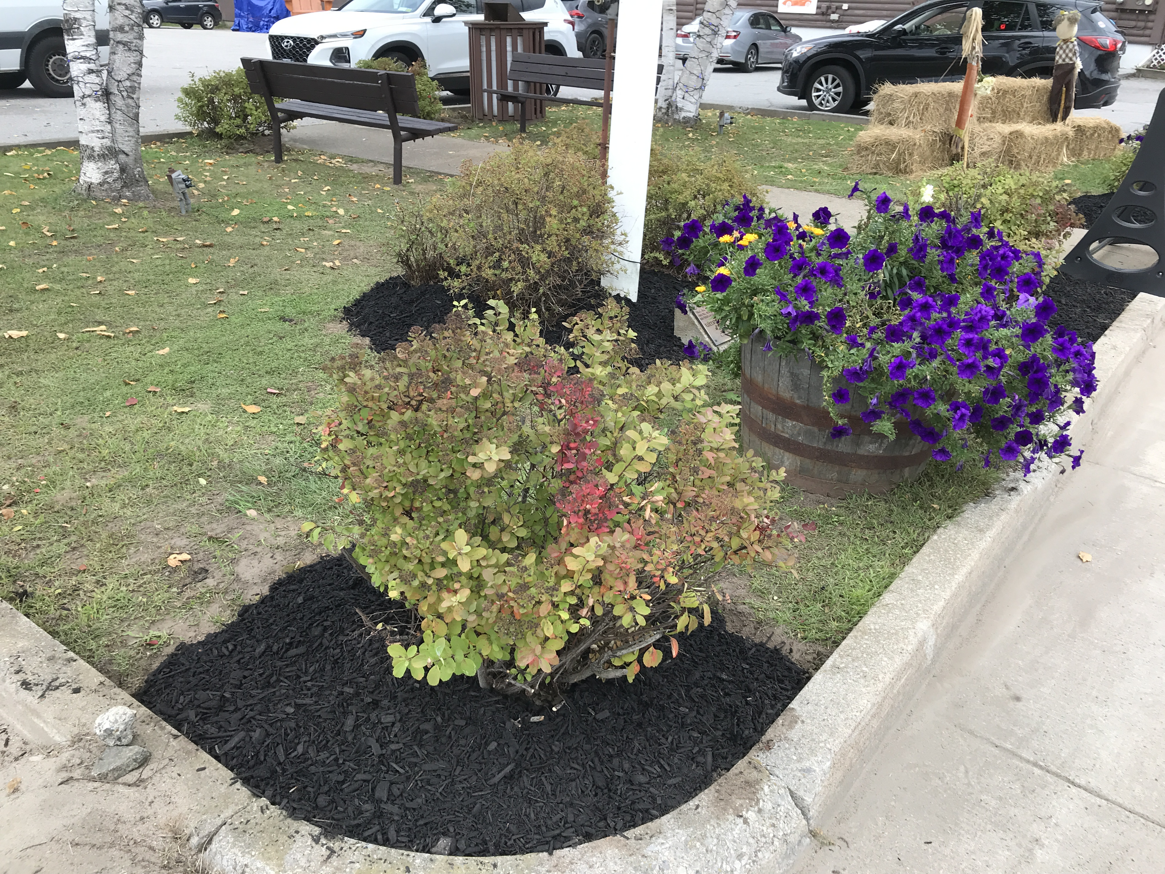
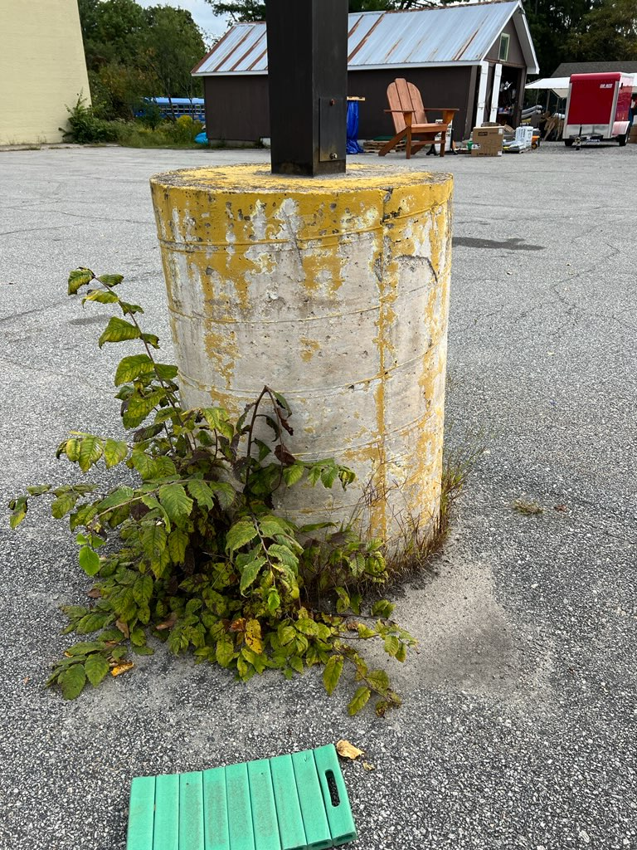
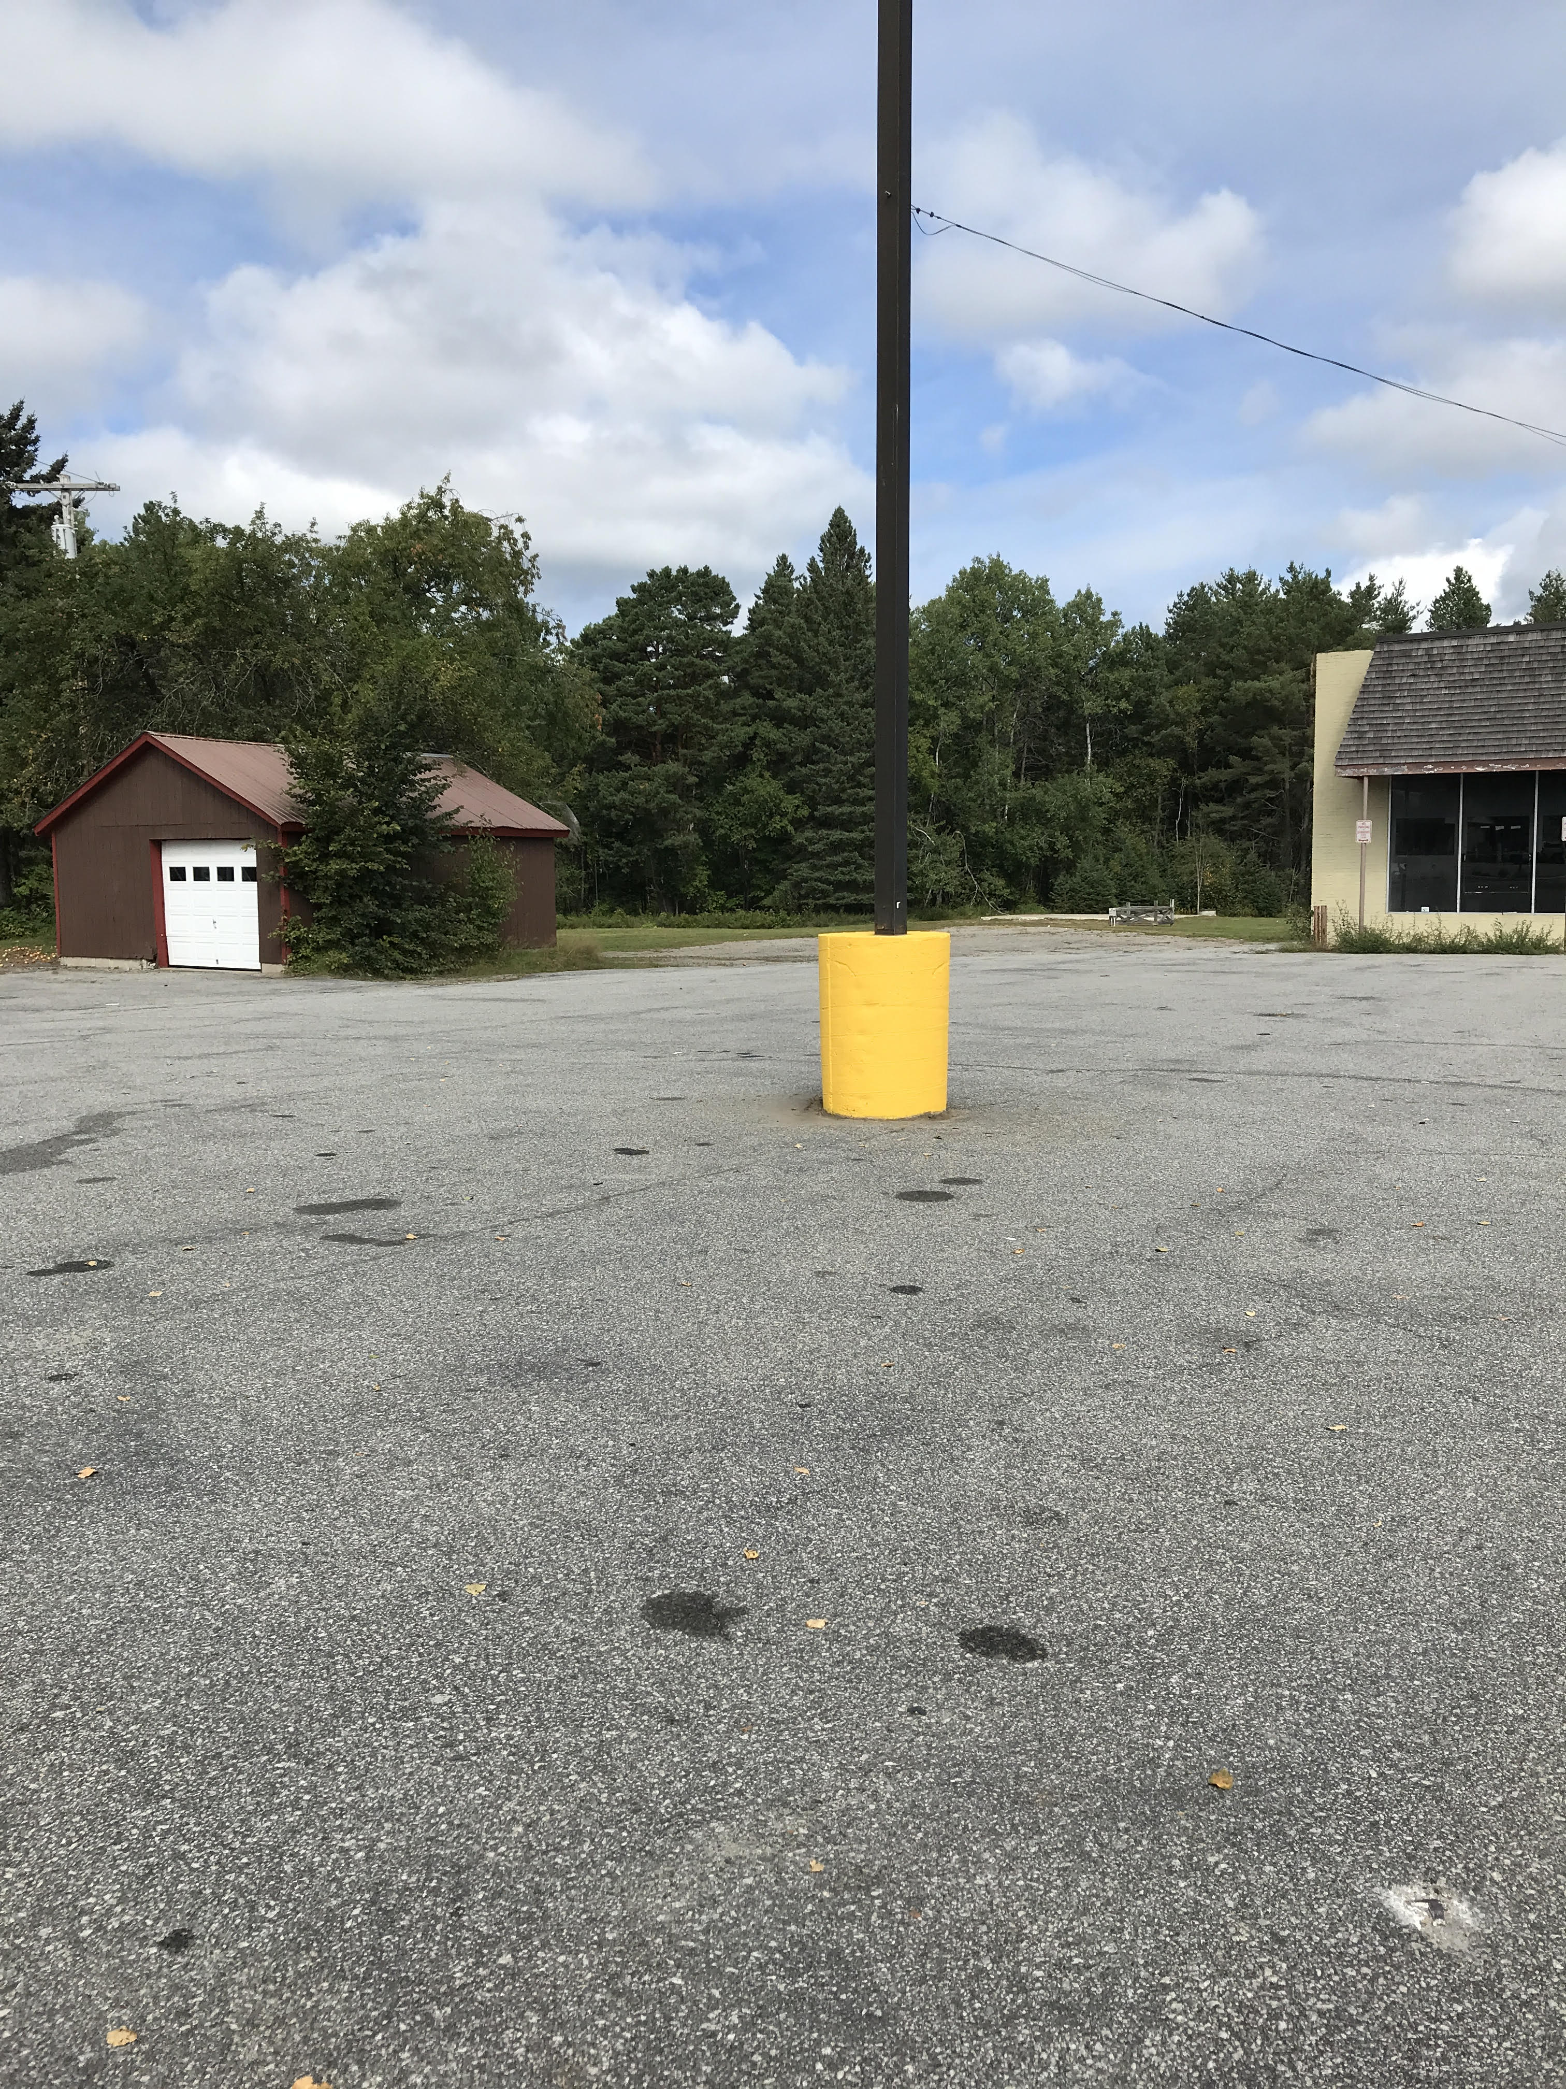
Projects Big & Small
Quick & Easy Fixes

Slide 17
Main Street America Punch List ADA Complaint DOT Sidewalks -Large Scale Project Sweep sidewalks Sweep, repair, and crosswalks Rebrick/spray bump outs Mums/Fall displays (Townsend’s and Welcome Center) Done Recruit new Garden Club Volunteers Paint benches in pocket park Done Prune bushes at pocket park Done Spray paint post in parking lot Done Spruce up and dust Indian Lake Museum Add artifacts to the Welcome Center to help promotion of IL Museum Line Item for projects in the Town’s publicity budget for revitalization projects $5,000 secured Trim tree in front of Welcome Center and the apple tree by side street Done Name for the subcommittee/Approval from ILCDC Identify Projects to address in BML

Slide 18
Parking lot posts at the Post Office/Add parking lines (Pending: requisition requested)
Sealcoat and restripe Welcome Center parking lot (planned for 2023), Submitted in 2023 budget but denied due to planned construction for charging station implementation
Clean out drain (weeds growing up as drain is clogged) at Welcome Center
Split rail fence and trees planted to create a buffer between DD Paving and Townsend
Provide Christmas trees for all yards (not budgeted for in 2022 or 2023)
Promote white lights through Snocade
Streetlights replaced with LED (Pending this is an ongoing project with support from National Grid – we are 50% completed in Indian Lake; 100% completed in Blue)
Town logo on the beach building; need a First Aid sign on Lifeguard door; handles on the doors not handicap (they are knobs); bathroom doors aren’t code; need gender signs on bathroom doors.

Slide 19
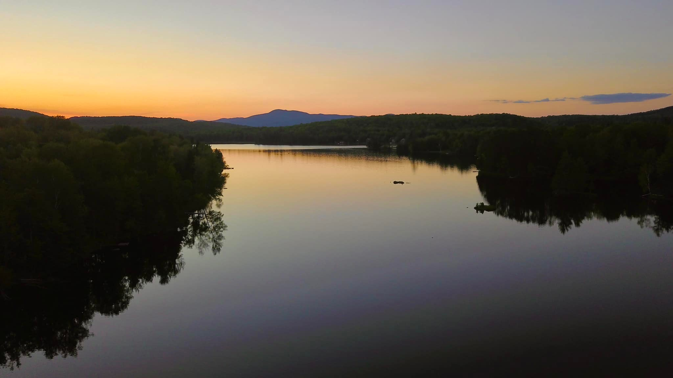
Questions
This first two PowerPoints are available at www.indianlakeadk.com

Slide 20
Thank you. We look forward to working with you!

